Slide 1
Disclaimer
Everything You see in this presentation is publicism. It's not addressed to any of You personally. This is my own opinion, formed by me. Exists articles that attempt to refute this opinion. I want to note that the absence of details, intentionally excluded from the presentation in order to simplify perception, is not considered a reason for refuting my presentation by articles, books, etc. I Also want to note that my opinion is supported by some articles of other people. I do not impose this opinion on anyone. Any coincidence to consider casual. You decide to APPLY this material to yourself or NOT. I also pay attention to an important detail: all the arguments about quality belong to the production level.

Slide 2


Want to become a programmer

Slide 3


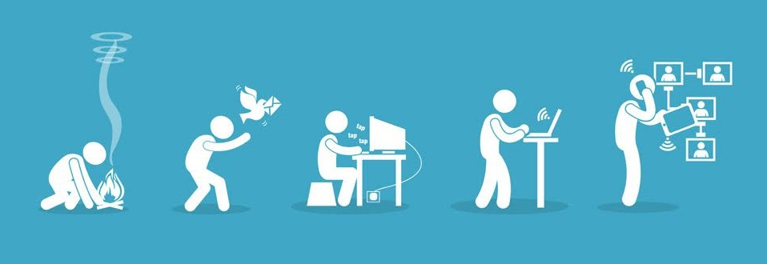

Slide 4
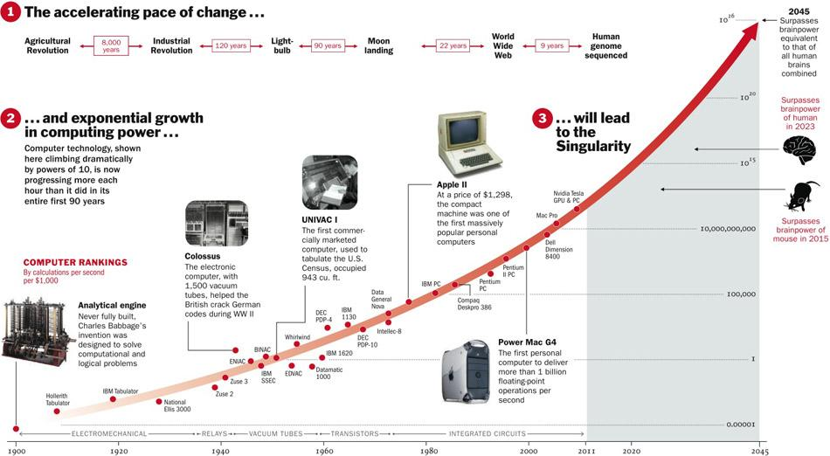
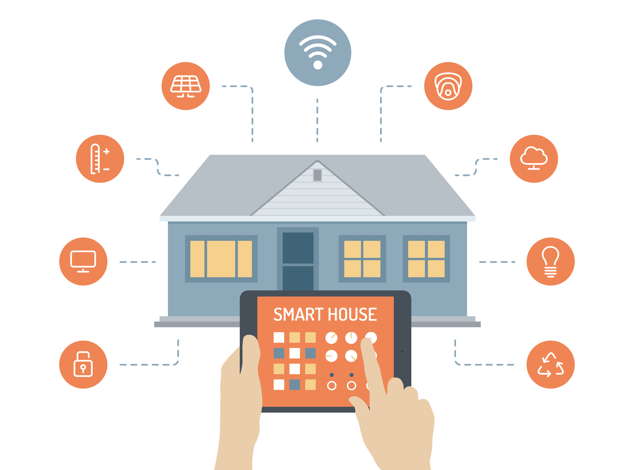
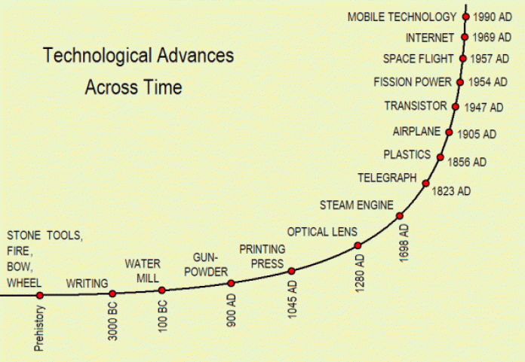


Slide 5


BE
LIKE
ME

Slide 6

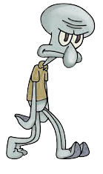
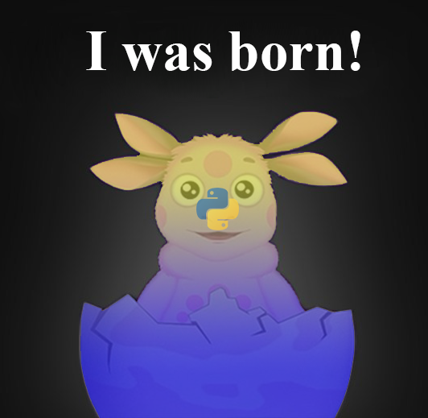

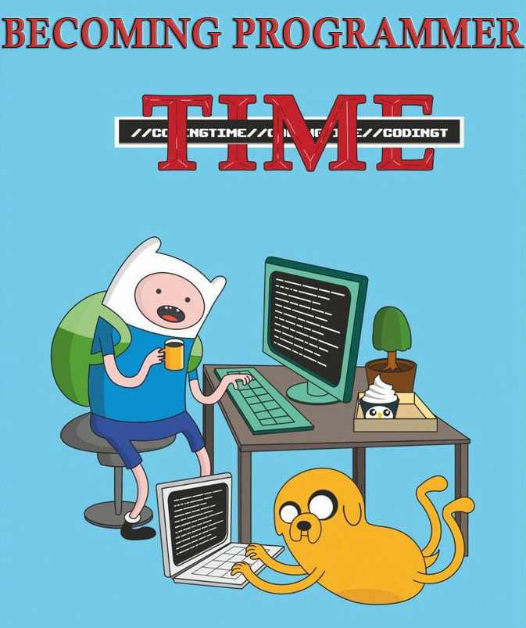


PROGRAMMER

Slide 7

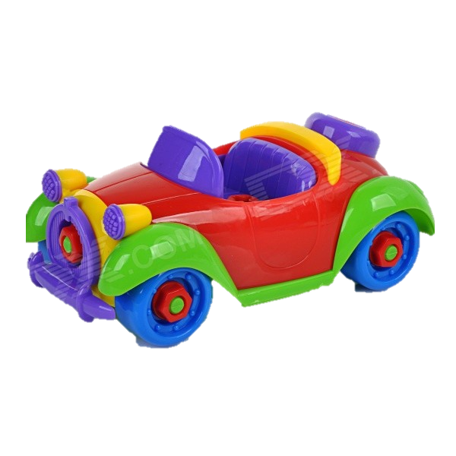

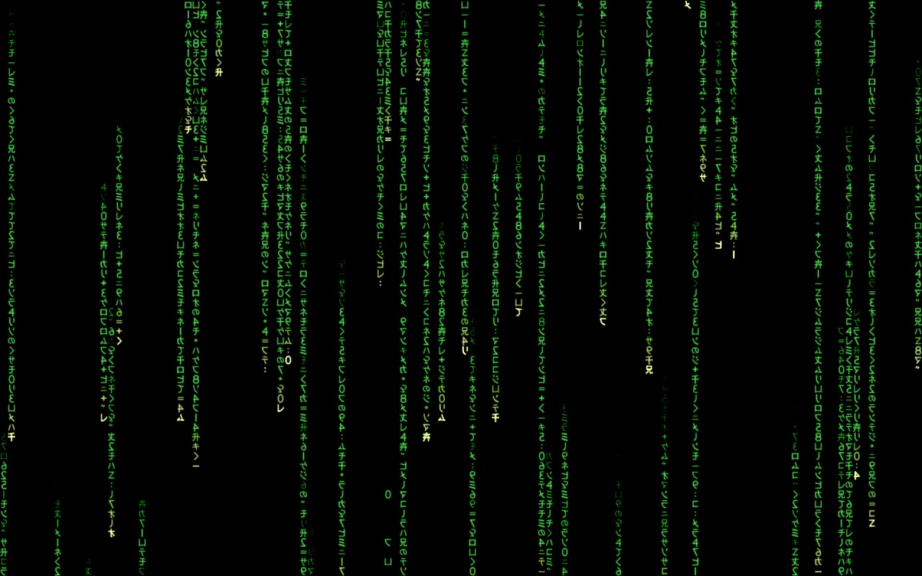

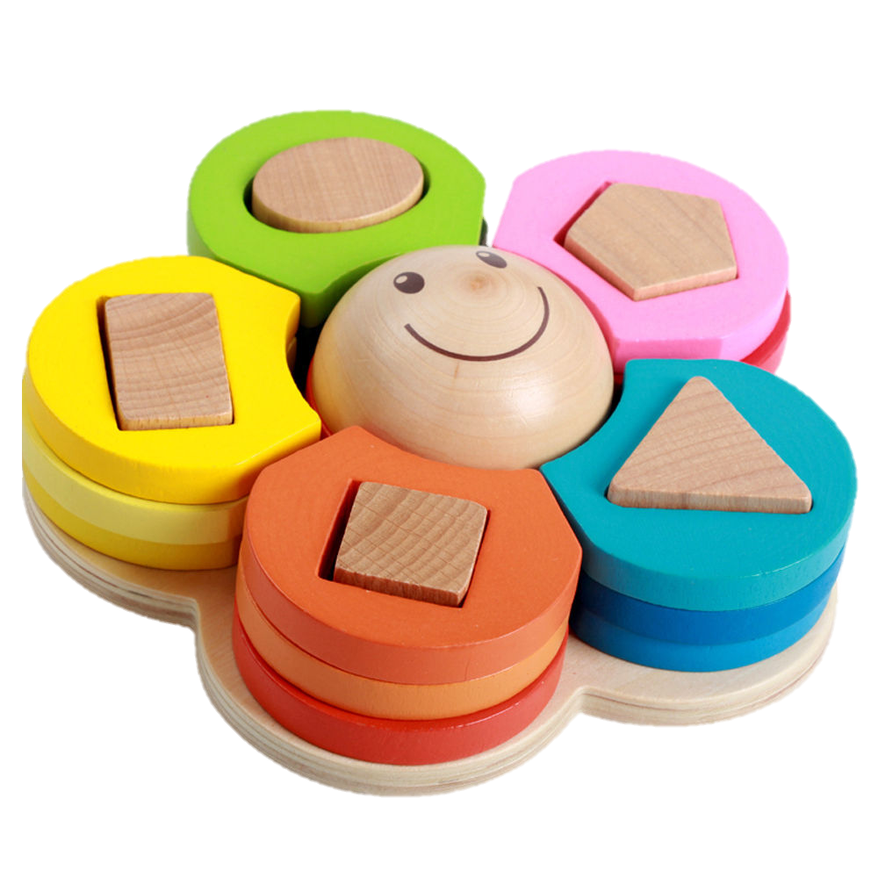
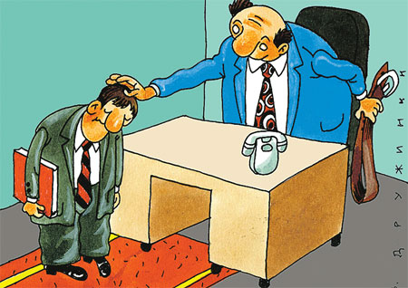




Slide 8
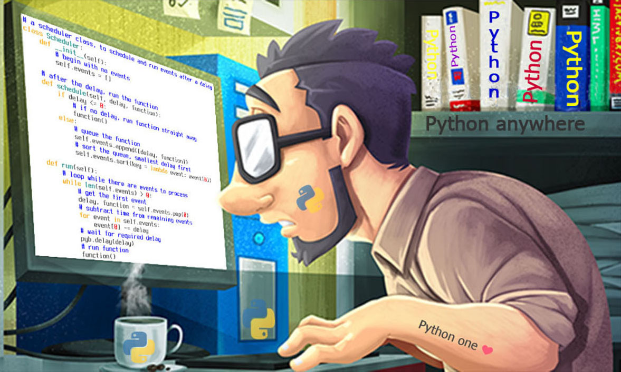

under-coder - a person who doesn't have the ability to write code, should not work with code (can’t write a code) under-programmer – coder, but bad programmer (can't think like a programmer), should not work as a programmer (can work as a coder)
monkey coder - person who can write a code, but does it poorly (this person writes a bad code)

Slide 9
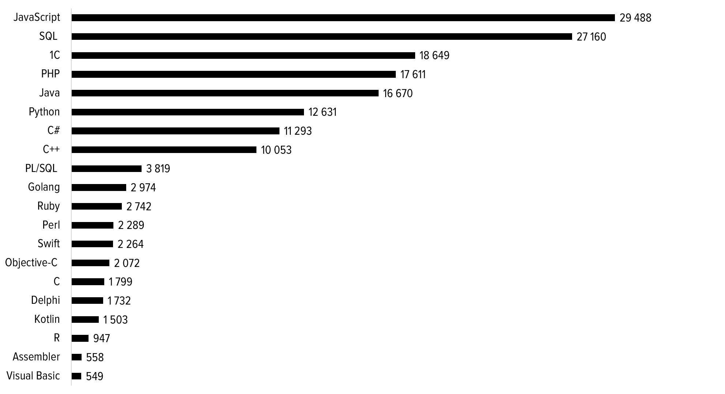

Clojure
Groovy
Kotlin
Ceylon
JRuby
Jython
Nashorn

Slide 10

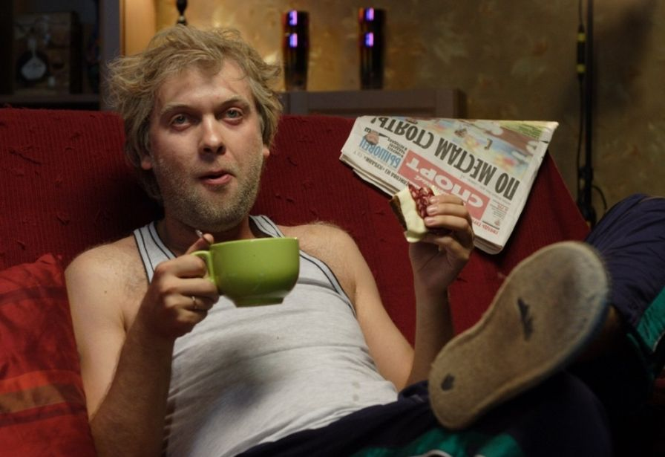
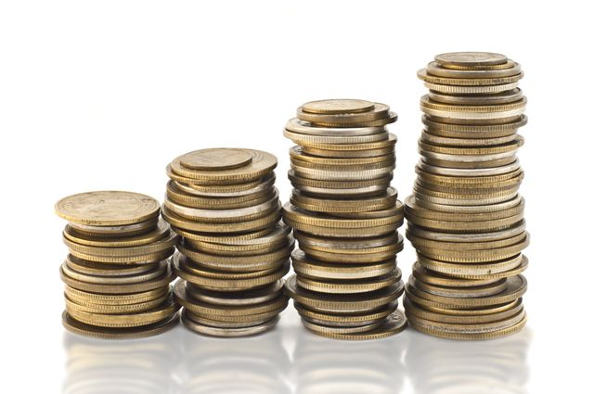

Slide 11

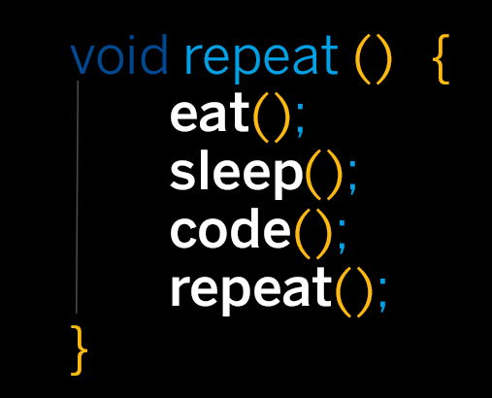

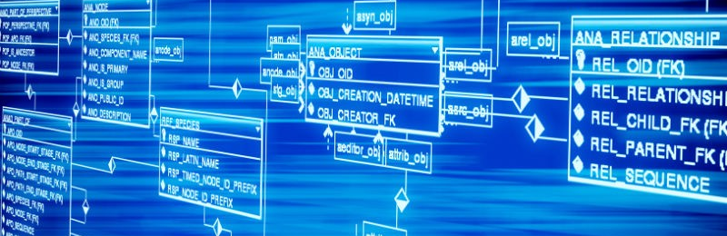

Slide 12




Slide 13

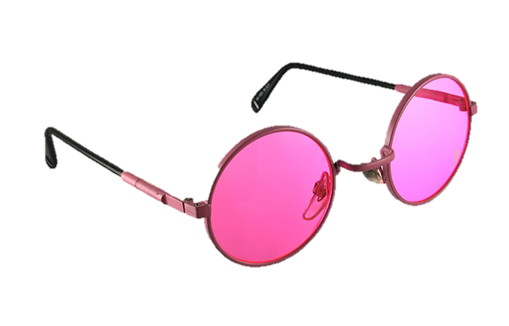
Thank you for your attention!
P.S. Sorry about the broken rose-coloured glasses if you had them.

